Slide 1

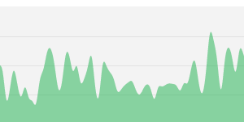

Alan Edelman, Jeff Bezanson
Viral Shah, Stefan Karpinski
and the vibrant open-source community
150
100
50
0
←Daily Contributions
2012
2013
Computer Science & AI Laboratories

Slide 2

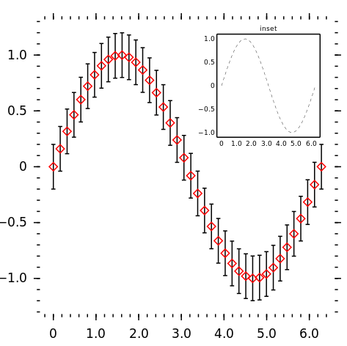
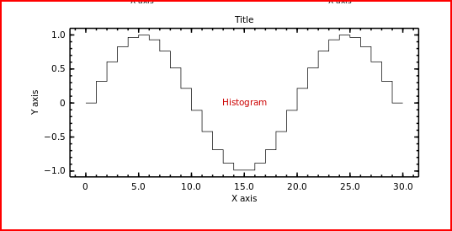
Collaborative Coding Vision (mockup)
Realized in 18.337/6.338
Julia
Bob: (9:15am) The folks at BigCorp are excited about working together to explore their data Alice: (9:42am) I’m running the regression. What do you think? Mike: (9:45am) The daily cycle is getting clearer. Wow! a good fit!
Bob> include(“MyBigDataSet”)
Lucy> h=hist(bigdata[:])
Mike> svdvals(bigdata)
Alice> qrfactor(bigdata)
Mike> daily_cycle()
Daily Cycle
Data Histogram
“It’s like having google docs for big data exploring!”

Slide 3

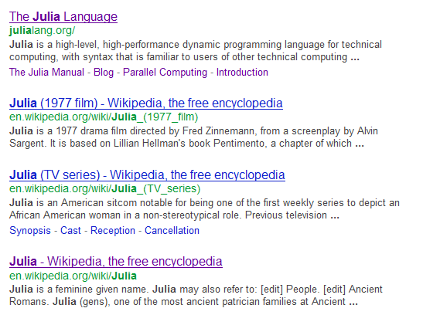
Google Julia

Slide 4
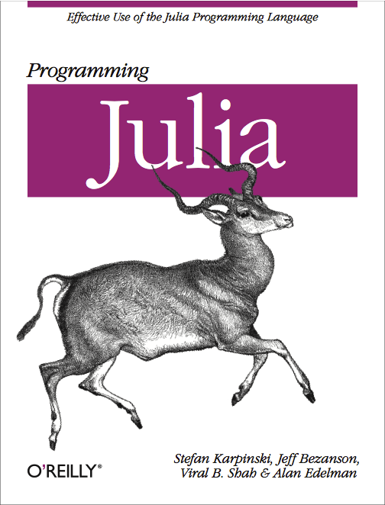
Julia Facts
Released: February 2012
Technical Problem: Computing Environment
  New
  Fast
  Human
  Open Source
  Flexible
  Scalable for “big data” and “many processors”
You don’t need our permission to try it, or to contribute
←Forthcoming
Book

Slide 5
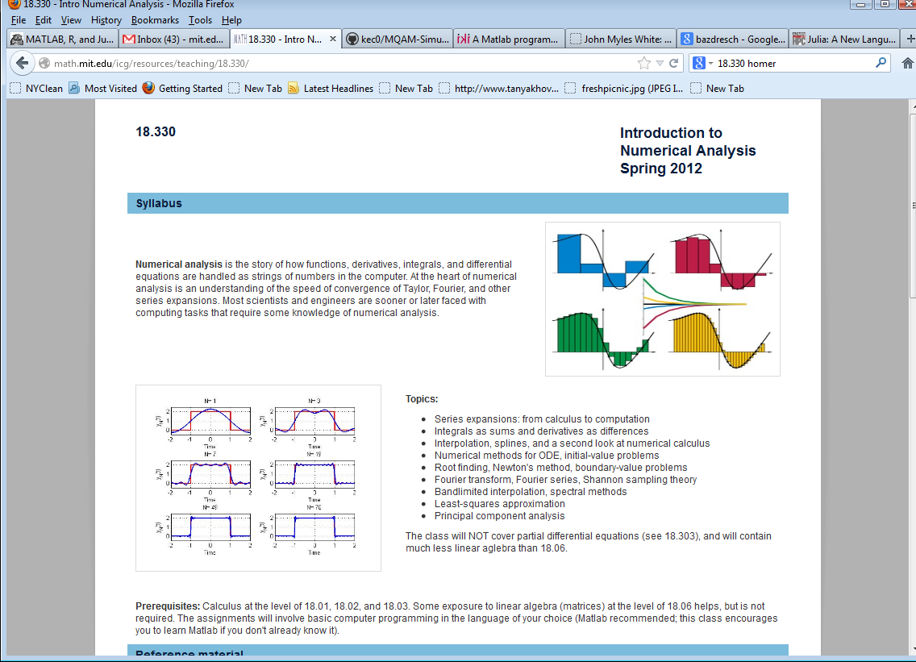
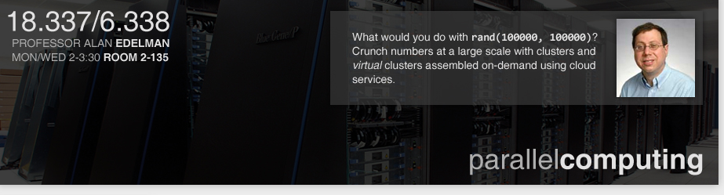
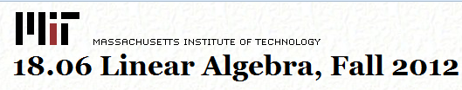
Julia in the traditional classroom

Slide 6
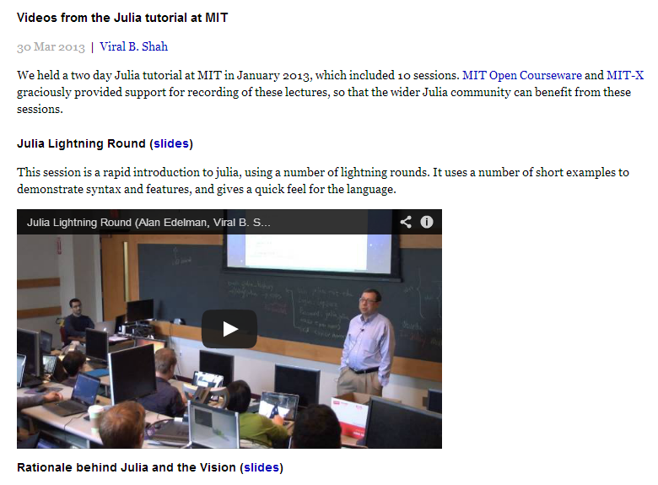
Julia in the MOOCs classroom
Google: julia videos mit
Julia is MOOCs
ready for so many
kinds of classes!

Slide 7
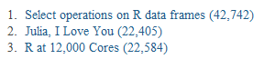
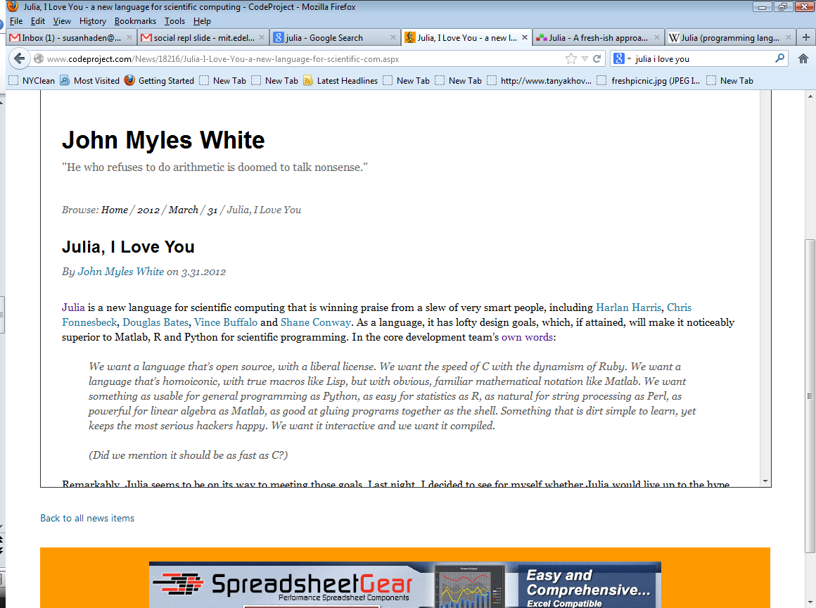
Julia in the News
TechCrunch
Top 100 R-posts of 2012 (Page Views)
“Julia is a new language for scientific computing that is winning praise
from a slew of very smart people, … As a language, it has lofty design
goals, which, if attained, will make it noticeably superior to Matlab, R
and Python for scientific programming.”
Written by the author of “Machine Learning for Hackers”

Slide 8
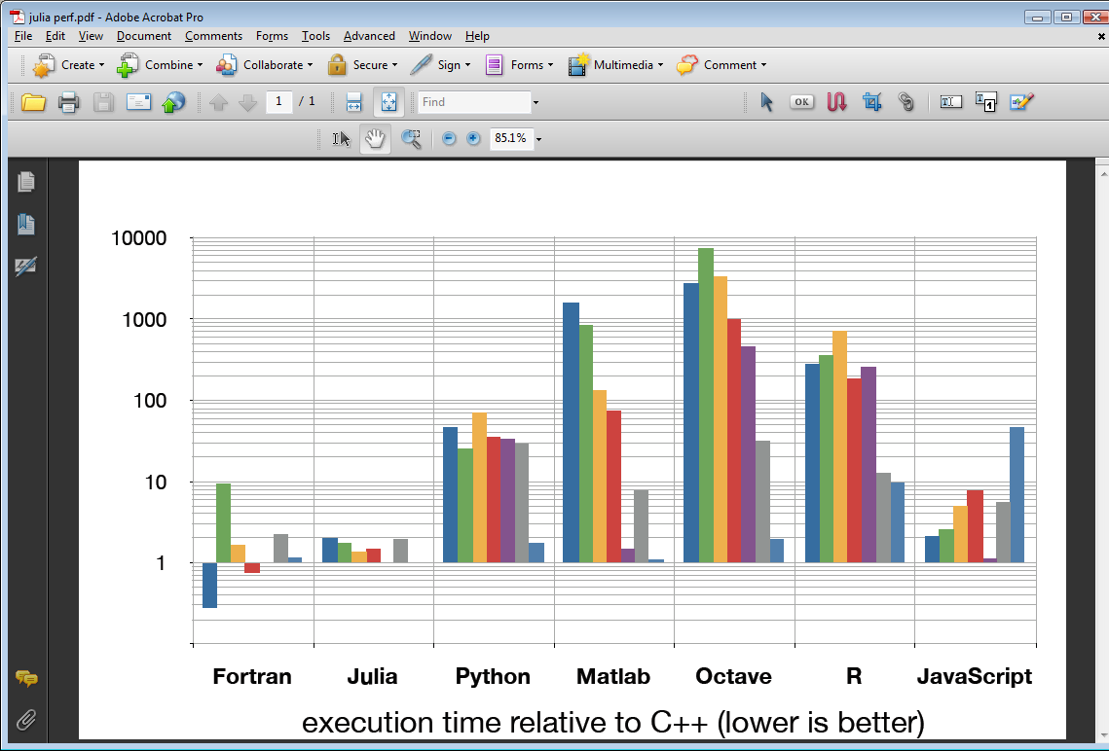
Benchmark
Performance
fib
parse_int
quicksort
mandel
pi_sum
rand_mat_stat
rand_mat_mul

Slide 9




Why a fresh approach?
Current Players:
  Life in the 1980’s:
    Performance was poor, but nobody cared
    Programs were easy (even fun!) to use
    Processors were getting faster anyway
  Today:
    Users want much more
    More sophistication
    More speed
    Easier to use, Easier to Collaborate
    Bigger Machines
    More Open, more Extensible
    Easy Deployment

Slide 10
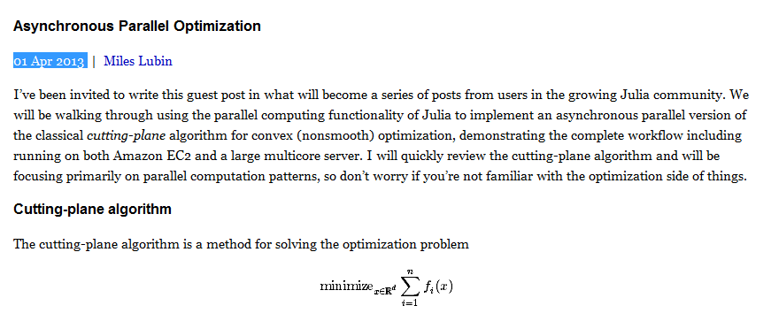
Every Day a New Package
(Tailored Toolkit!)
At least 150 by now
A hot optimization algorithm used
in machine learning!
Implemented using Julia’s asynchronous
parallel technologies

Slide 11
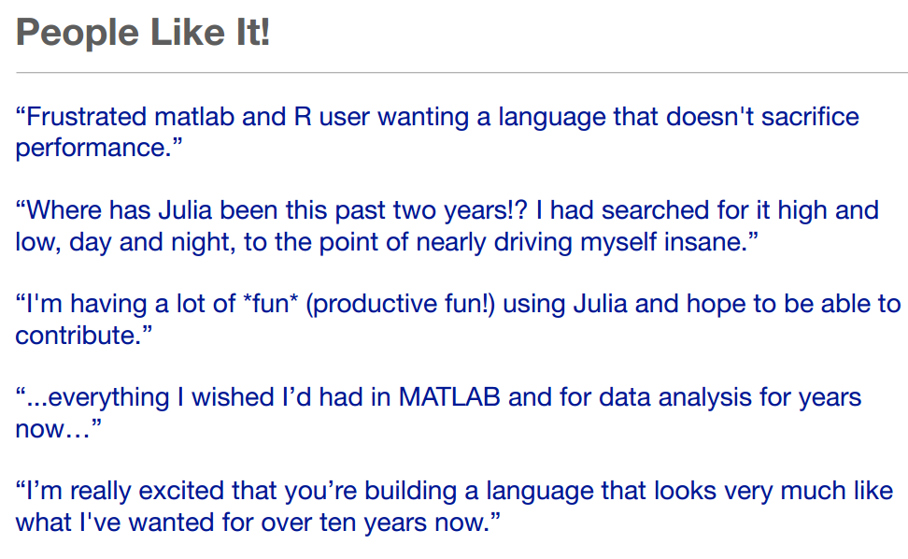

Slide 12
Innovation 2013 Style
  We are building what we wanted
  They said it could not be done
  Others are joining us!
  What do you want?

