Slide 1

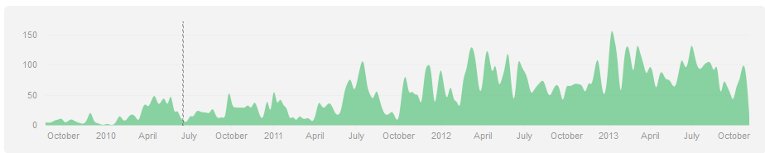

Alan Edelman
Jeff Bezanson, Viral Shah, Stefan Karpinski
and the vibrant community
Computer Science & AI Laboratories

Slide 2

Our Goals
Design a high performance technical computing environment for today’s world
  Performance: not an afterthought
  Parallelism: not an overcoat
  Data sizes: everyday to “Big data”
  Doesn’t baby you; let’s you grow
  Cloud served, on desktop, or embedded…
Working with Julia should be a better experience than what people are generally using today

Slide 3
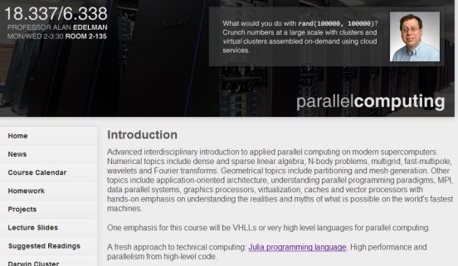
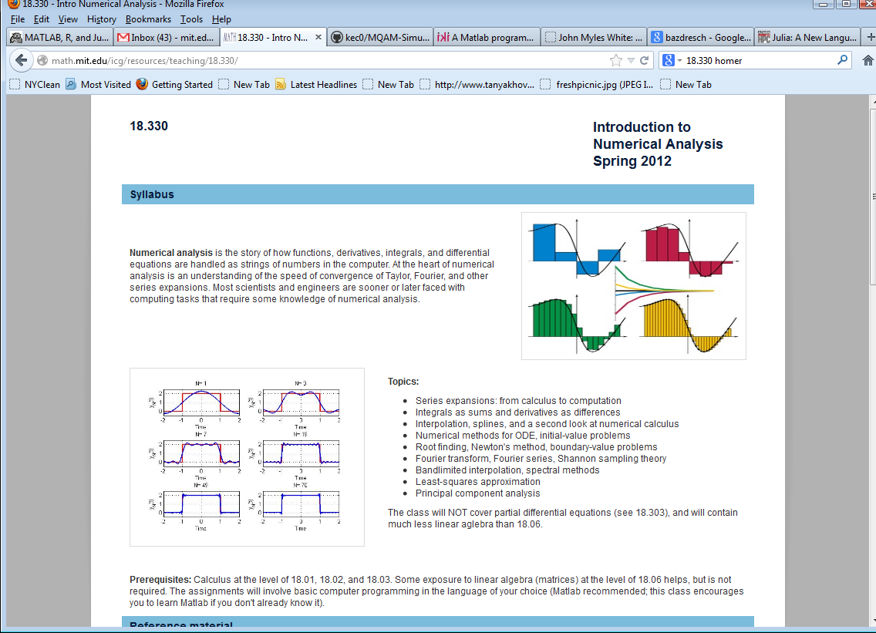
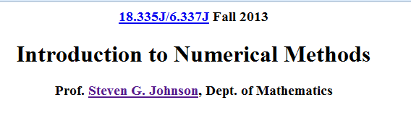
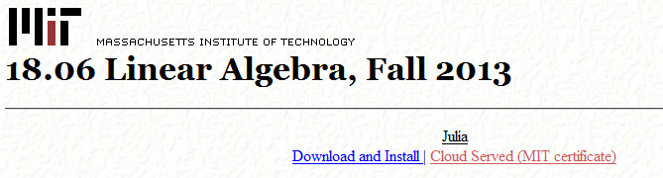
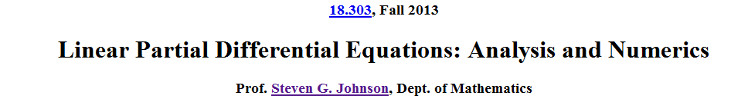

Julia in the classroom
Classes starting up at Harvard, around the country
and around the world…..
Schools starting up compute servers for Julia ….

Slide 4
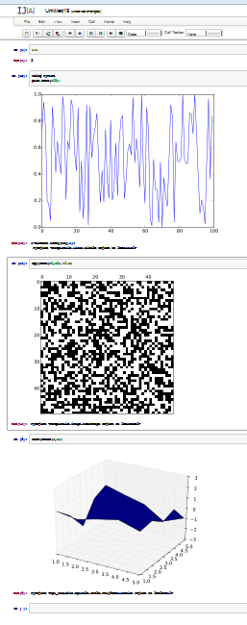


Running Julia
Start by pretending you are in your current environment
  learn something a little new, stretch your comfort zone
  enjoy the performance
  graduate to programming with new conveniences and in better ways

Slide 5
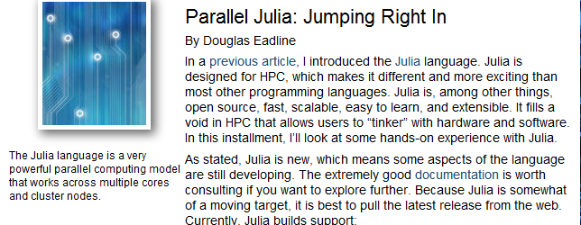
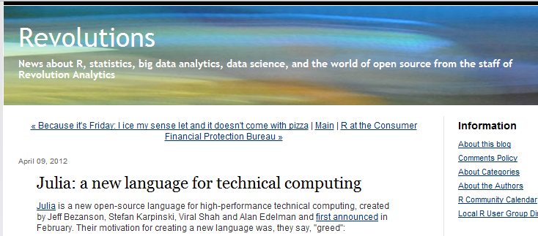
Julia in the headlines

Slide 6
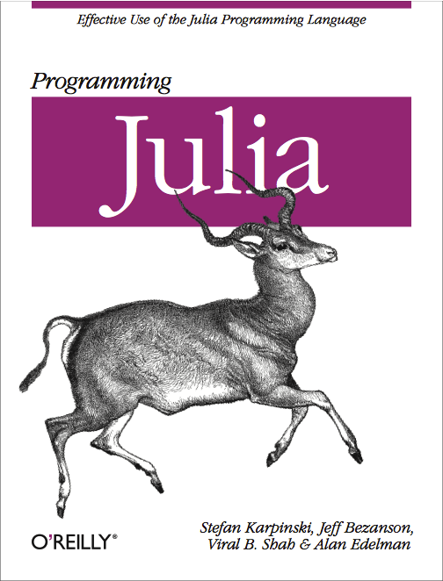
Julia in the Real World
← Forthcoming Book ???

Slide 7





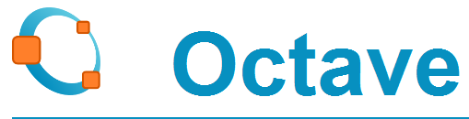



Why a fresh approach?
  Life in the 1980’s:
  Technical Computing Specialists (Fortran!)
  Everyday computer use: Not much, Email use starting
  Surface Layer to bridge the technical gap
    Performance was slow, but nobody cared
    Programs were easy (even fun!) to use
    Processors were getting faster anyway
  Today:
  Users are more sophisticated
  Line is blurring between developer and user
  Want performance, scalability,
  Want collaborative environments

Slide 8
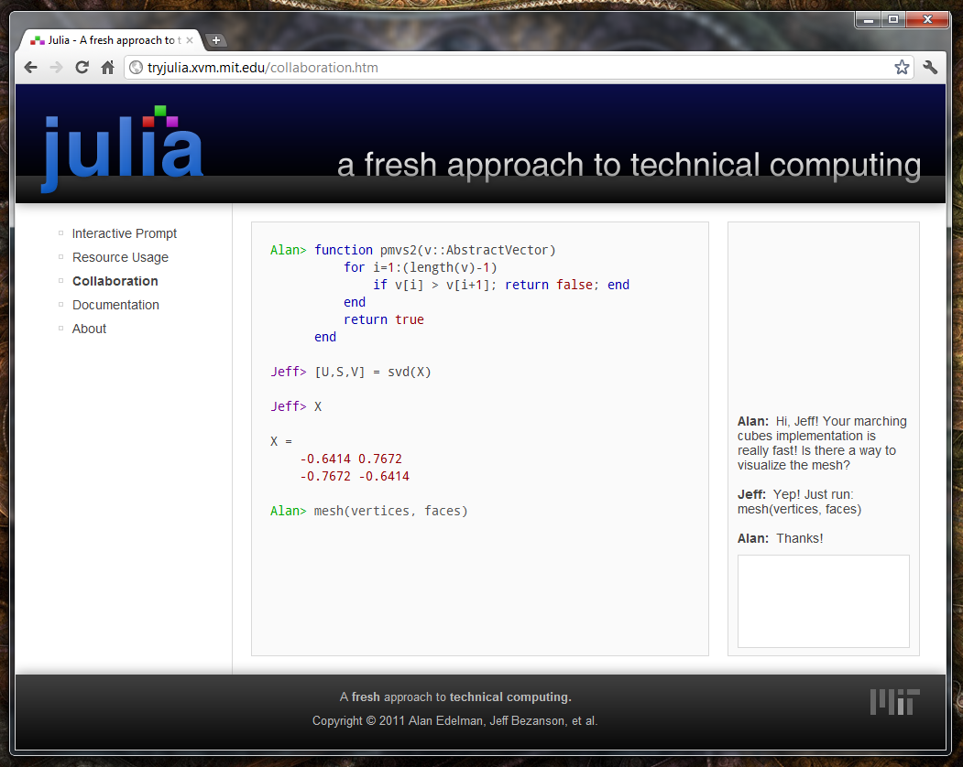
Collaborative Coding (mockup)
Realized in 18.337/6.338
Collaborative coding environment
Send messages to your colleagues in real time
It’s like
having
Google
docs for
coding!

Slide 9
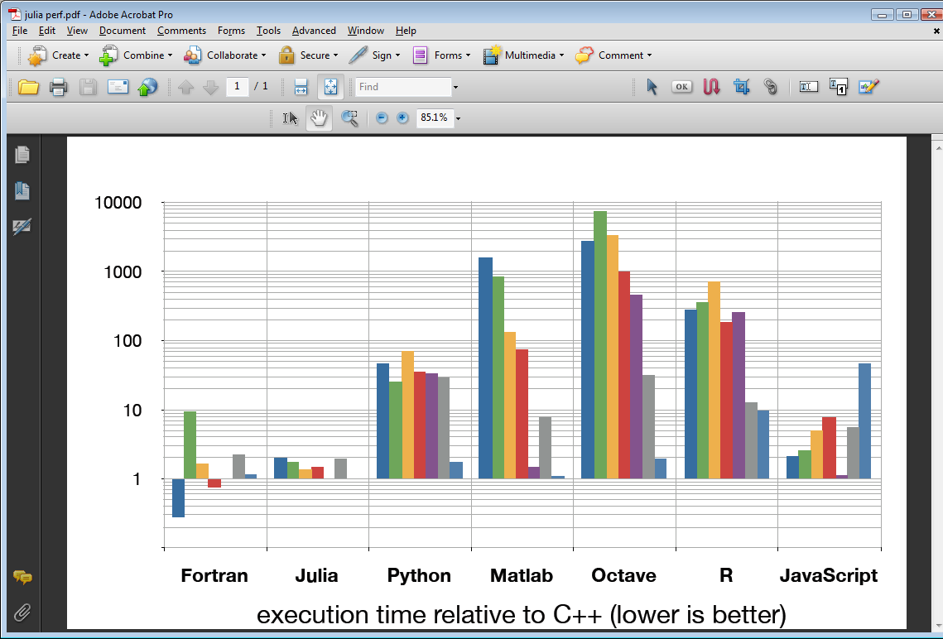
Benchmark
Performance
fib
parse_int
quicksort
mandel
pi_sum
rand_mat_stat
rand_mat_mul

Slide 10
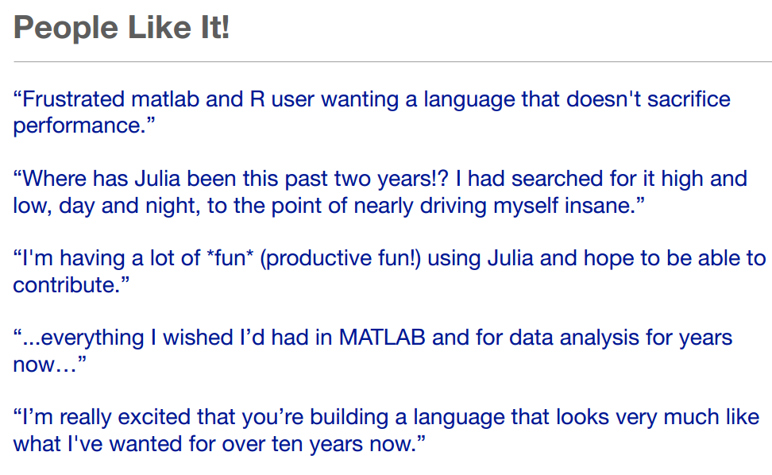

Slide 11

Why is Julia fast?
Traditional:

Slide 12
DEMOS
JULIA NOTEBOOKS FOLLOW

