Slide 1
Alan Edelman
Mathematics
CSAIL
Jeff Bezanson, CSAIL
Viral Shah, Stefan Karpinski
Students in 18.337
2012 IEEE High Performance
Extreme Computing Conference (HPEC ‘12)
Sep 11, 2012
Computer Science & AI Laboratories

Slide 2
Summary: Our Research Question
Design a high performance technical computing environment for today’s world.
What would it look like?
What architectural features do we want?
Our answer:

Slide 3
What’s in a title?
Julia is a high-level, high-performance dynamic (programming language)!

Slide 4
“Media”

Slide 5
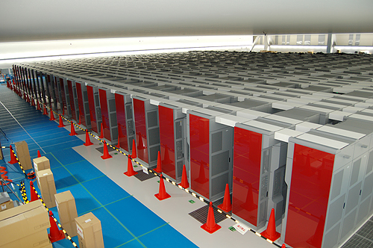
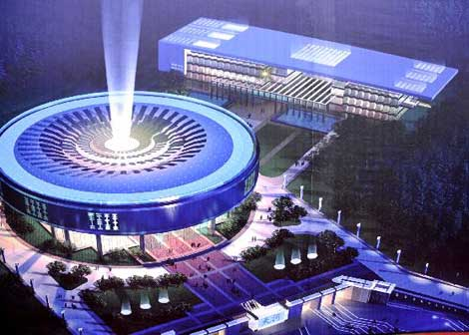
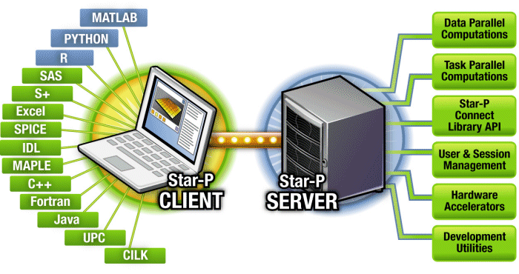
HPC Lessons
K Computer (Kobe, Japan)
Tianhhe-1A (Tianjin, China)
Few Composable Libraries
Inflexible Parallelism
Jaguar (Oak Ridge, Tennessee)
Curse of the idiosyncratic platforms

Slide 6
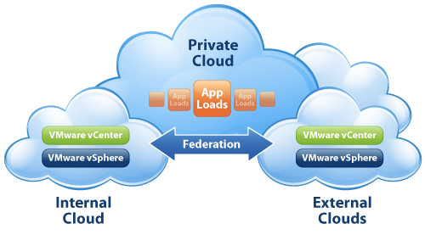
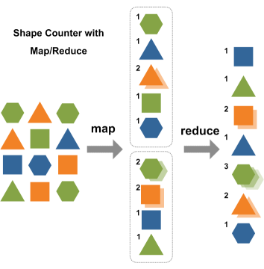
“Disconnected” Technical Computing World
Desktop Productivity
Cloud Potential
Supercomputer Power

Slide 7
“Disconnected” Technical Computing World
Desktop Productivity
Cloud Potential
Supercomputer Power
☺Easy on Humans
☺Non-Expert Users
☺Interface to vast libraries
☹Desktop Performance
☹Deep Chasm to cross
☺The Raw Power
Hard on Humans
Software
☺The Village
☺The Market
☺The Availability

Slide 8
Web Interface (mockup)
Interactive 2-D plots
and 3-D visualizations
Read-evaluate-print
loop
Control a cluster from your browser
---
Growing/Shrinking On demand

Slide 9
Performance Monitoring (mockup)
Real-time CPU and Memory usage for each node
See who is using the cluster’s resources

Slide 10
Collaborative Coding (mockup) Realized in 18.337/6.338
Collaborative coding environment
Send messages to your colleagues in real time

Slide 11
Julia’s Features So Far
Desktop Productivity
Cloud Potential
Supercomputer Power
Read-Evaluate-Print-Loop
☺ Sky’s the limit
☺ Grow-Shrink Resources
Availability
Collaboration

Slide 12
Julia Community
70 Contributors
>600 on Mailing List
Keno Fischer (Harvard) ports to windows
350,000+ page views

Slide 13
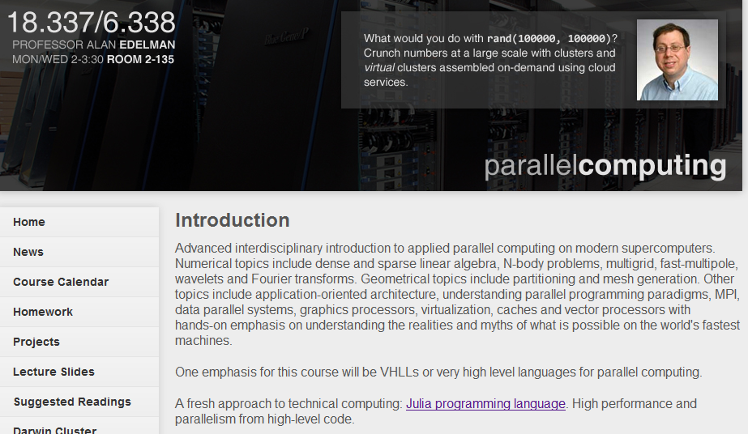
Julia Community
70 Contributors
>600 on Mailing List
High School Student (now at Harvard) ports to windows

Slide 14
“By Design” vs. Evolutionary

Slide 15
Julia is open source
Announced open source, February 2012. Significant community established around Julia in a very short time! We seem to have struck a chord!
The challenge is to continue to be established, and trusted!

Slide 16
Architectural Features
Serial Performance not an afterthought

Slide 17
Benchmark Performance
fib
parse_int
quicksort
mandel
pi_sum
rand_mat_stat
rand_mat_mul

Slide 18
Serial Performance
Retrofitting for performance is harder than most people think
Famous last words: we’ll get it working now and make it fast later.
Speed can become a “social problem” if not a goal from the beginning
Julia is designed to support type inference
Julia does not manually teach the compiler about each library function, but rather sees all the library code

Slide 19
Integers Mod N Example
julia> k = IntegerMod{11}(2012)
10 mod 11
julia> k+k
9 mod 11
julia> k*k
1 mod 11

Slide 20
The Code
type IntegerMod{N}
k::Int
IntegerMod(k) = new(k % N)
end
+{N}(a::IntegerMod{N}, b::IntegerMod{N}) =
IntegerMod{N}(a.k + b.k)
*{N}(a::IntegerMod{N}, b::IntegerMod{N}) =
IntegerMod{N}(a.k * b.k)
show{n}(io, k::IntegerMod{n}) = println(io, "$(k.k) mod $n")
showcompact(io, k::IntegerMod) = print(io, k.k)
sizeof{T<:IntegerMod}(::Type{T}) = sizeof(Int)
convert{N}(::Type{IntegerMod{N}}, i::Integer) = IntegerMod{N}(i)

Slide 21
Matrix Multiply Just works!
julia> a = randi(2012,4,4)
4x4 Int32 Array:
777 177 1907 984
929 1540 1375 1220
773 988 1494 1159
1187 1228 565 91
julia> b = map(IntegerMod{11}, a)
4x4 IntegerMod{11} Array:
7 1 4 5
5 0 0 10
3 9 9 4
10 7 4 3
julia> b*b
4x4 IntegerMod{11} Array:
6 1 7 10
3 9 5 0
1 2 10 10
4 1 0 2

Slide 22
Architectural Features
Serial Performance not an afterthought
Solves the Two Language Problem

Slide 23
Solves the Two Language Problem
Old view: Technical computing is a few blockbuster algorithms written in another language that need to be fast and glue that can be very slow
Our view: best if implementations are in Julia itself
Best for human productivity
As long as the code is fast
Community no longer separated between implementers & users
Can inline library code into user code and user code into library code
Performance + Expressiveness = Whole libraries in an HLL

Slide 24
Architectural Features
Serial Performance not an afterthought
Solves the Two Language Problem
Parallel Computing not an afterthought

Slide 25
Parallel Computing Not an Afterthought
World needs flexible parallel computing
Elastic: Processors thrown at a problem when needed, removed when not needed
DAG scheduling the way of the future
Requires runtime system support
Perhaps it’s hard to manage people, but at least we try to choreograph large projects --- parallel computing needs more of this!

Slide 26
Parallelism not an afterthought
“Map-Reduce” is just not enough

Slide 27
More Features
Data readable from Hadoop, (HDFS)
Base Julia is open source
Dynamic type system
Efficient native code
Scalar numeric code at native speeds
Many library bindings
Designed to make that “first date experience” very pleasant

Slide 28
Why do we think we can succeed?
Experience: We know what real codes look like.
Dream Team: Computer Scientists who get numerical algorithms! Mathematicians who get computing!

Slide 30
Our dream team in place today!

Slide 31
You can be a Julia user
Imagine the forthcoming skyscraper and you can get in on the ground floor
Google: julia –obama
or julia downloads

Slide 33
GPUs?
Type machinery can be used for GPU code generation
Metaprogramming can compile a subset of user code to GPU
Not just calling an external GPU library

Slide 34
Cloud Streamlines Deployment
Lesson of Interactive Supercomputing
Staff was not developing high speed routines as much as they were compiling for idiosyncratic machines
Terrible loss of productivity
Some users did not have machines up and running
Installation even on “blessed” configurations were a nightmare

Slide 35
The Cloud
Encourages Collaboration
Enhances the 1st date experience
Makes Programming fun again!

